Slide 1
INSTALL SAP HANA, express edition ON LAPTOP.
Milind Parab

Slide 2
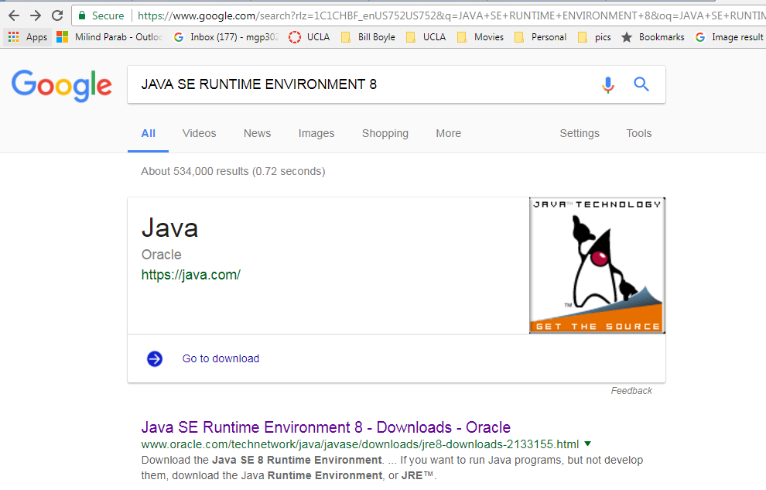
Download JAVA runtime environment.

Slide 3
Cont.
Download and install JAVA Runtime Environment.
http://www.oracle.com/technetwork/java/javase/downloads/jre8-downloads-2133155.html

Slide 4
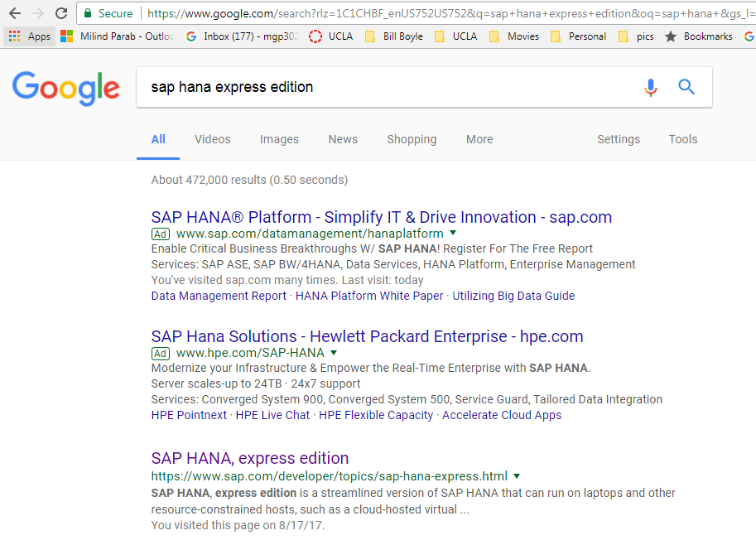
SAP HANA express edition. 3rd Link.

Slide 5
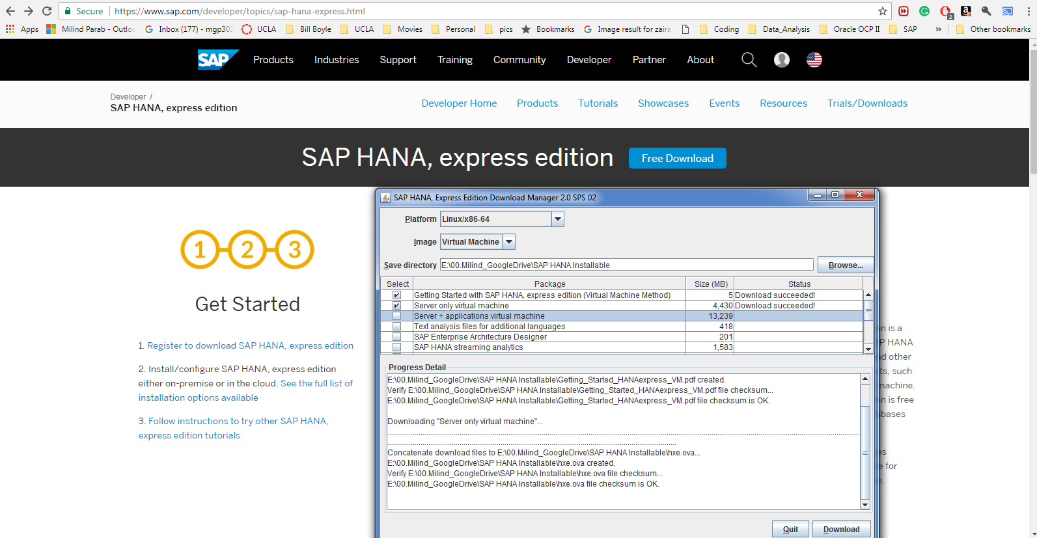
Download SAP HANA express edition.

Slide 6
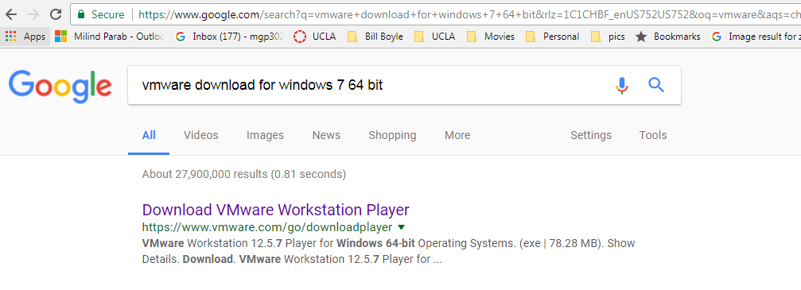
Download VMWARE for your windows system.

Slide 7
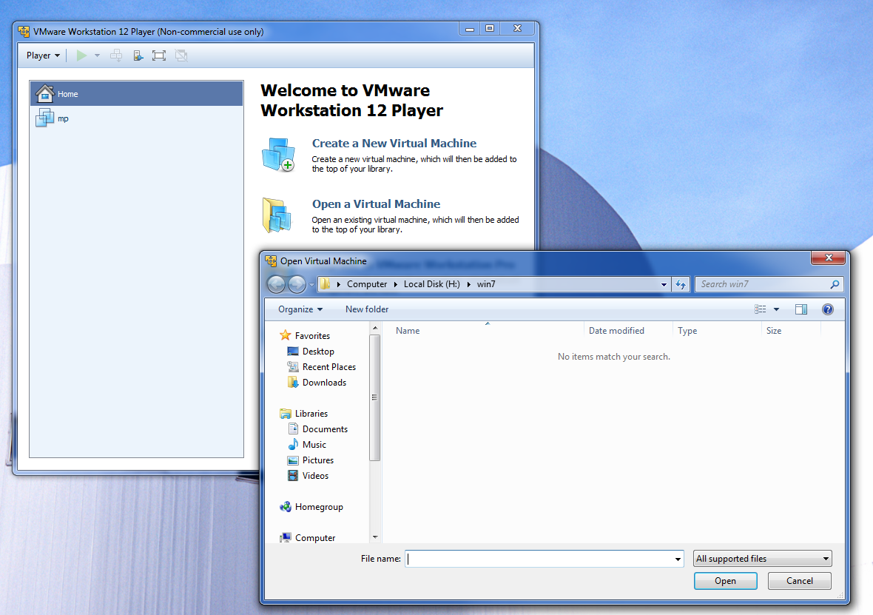
Click on open virtual machine.

Slide 8
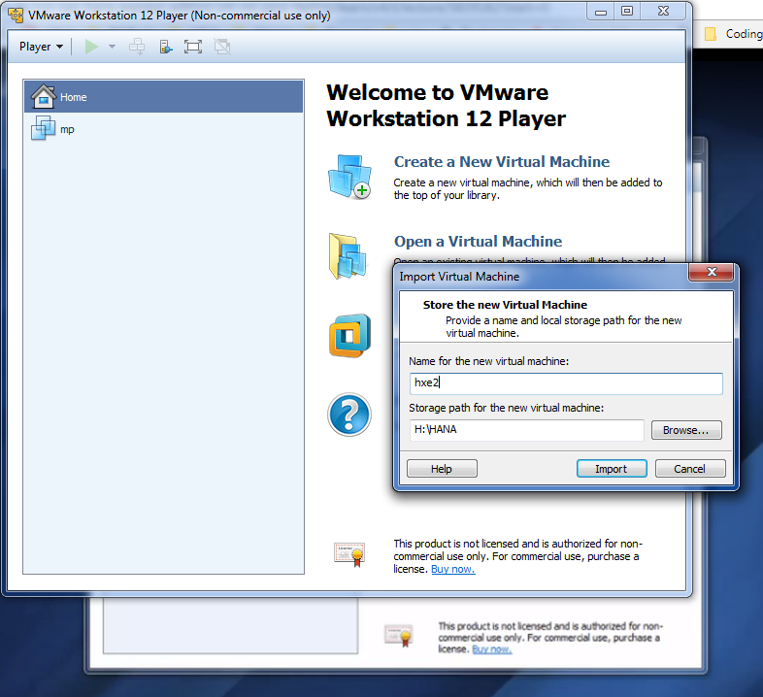
Cont.

Slide 9
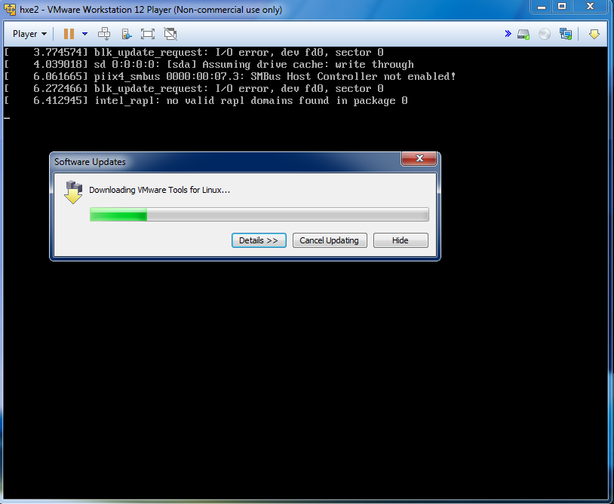
Start VM and click yes for download additional software.

Slide 10
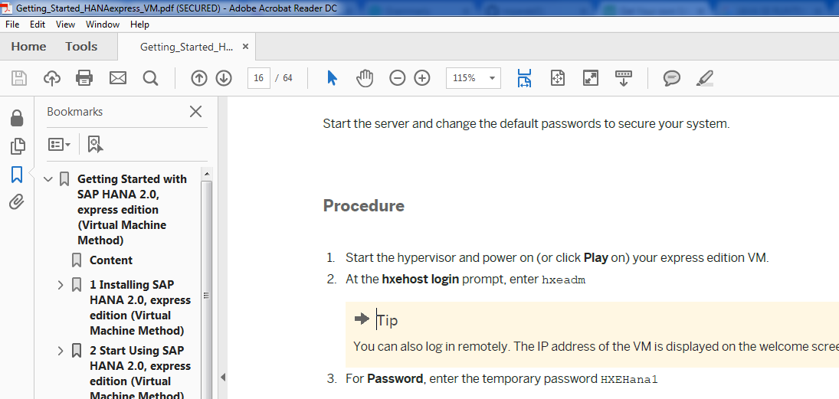
Log in and password for HANA.

Slide 11
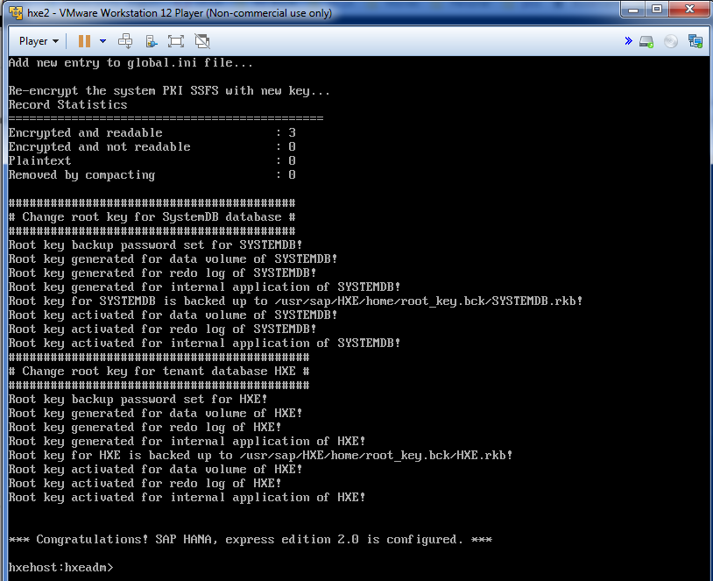
Once you change the password, you will see the below screen.

Slide 12
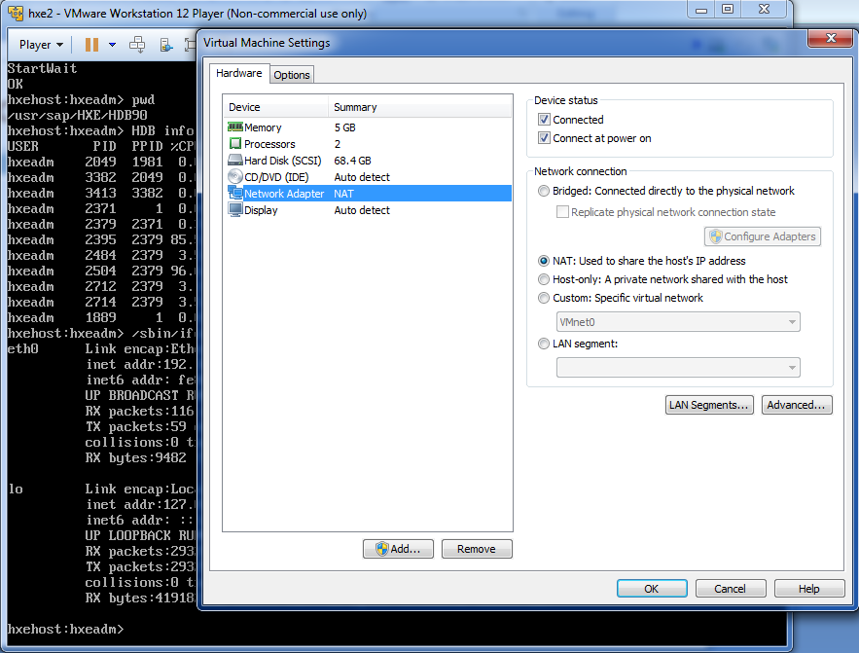
Network adapter setting to NAT.

Slide 13
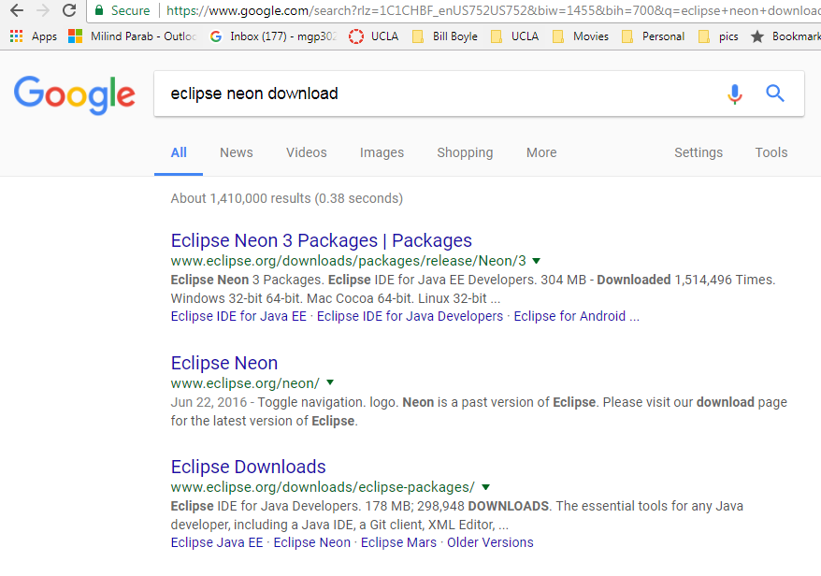
Eclipse Download.

Slide 14
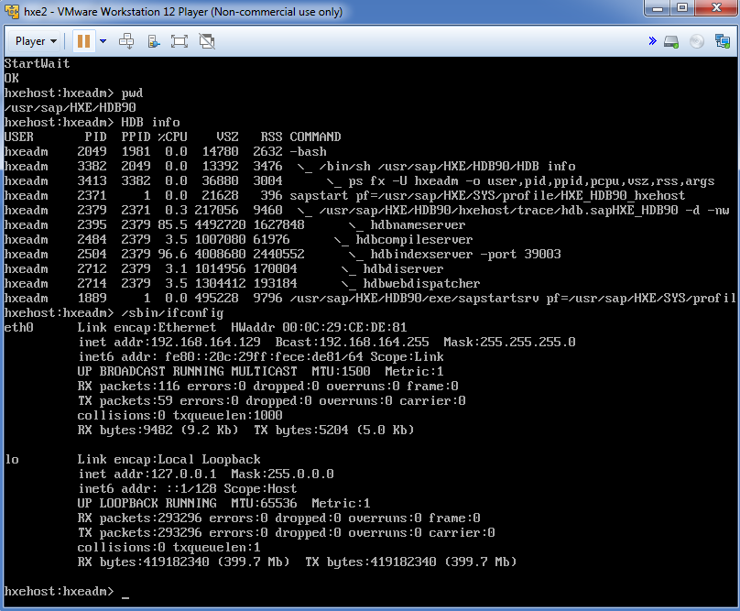
Make sure VM setting

Slide 15
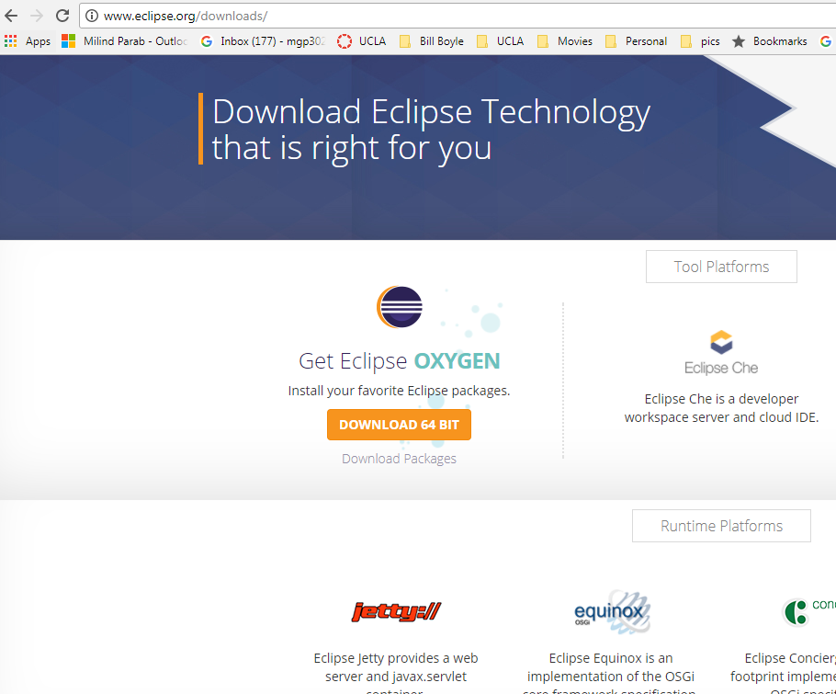
Cont.

Slide 16
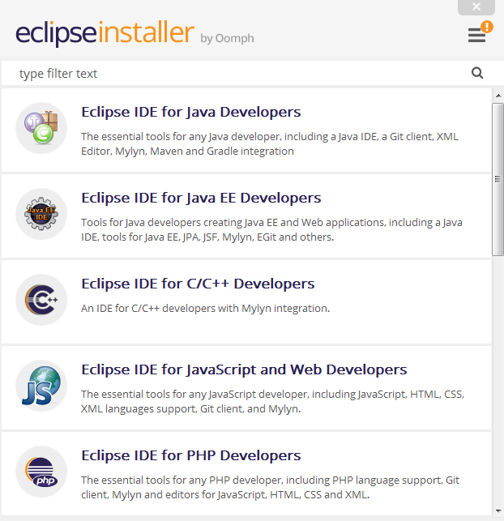
Eclipse IDE for JAVA EE Developer.

Slide 17
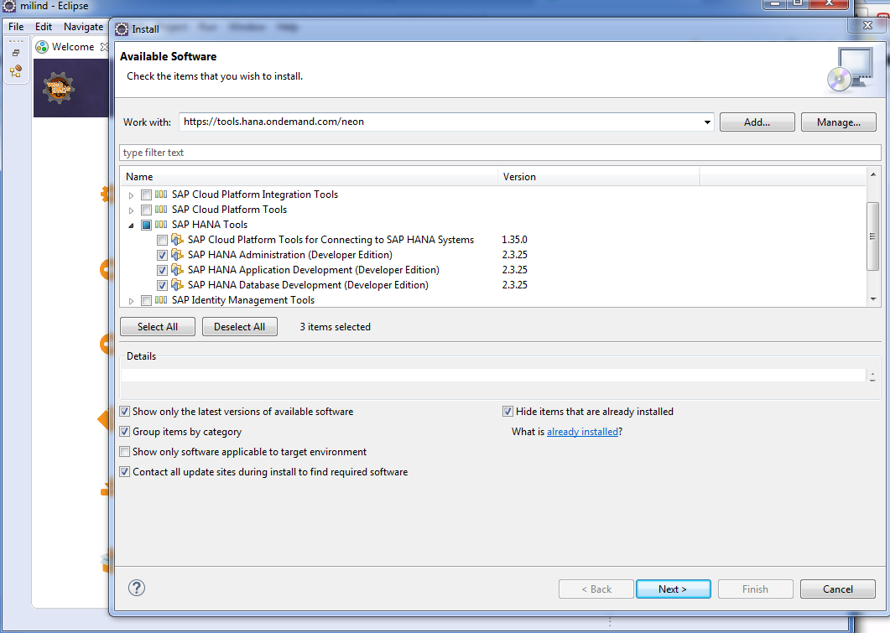
Go to new install software and download below three softwares.

Slide 18
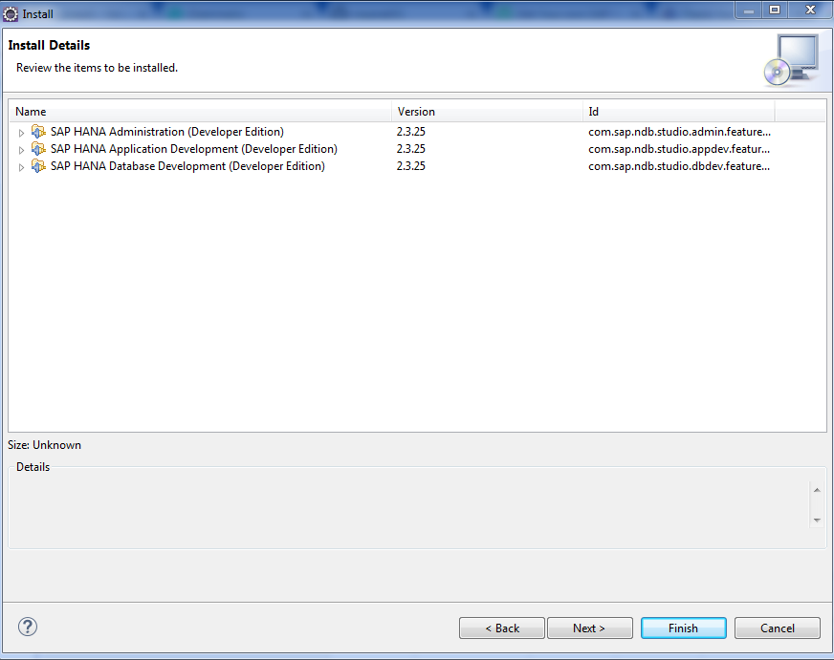
Click on next.

Slide 19
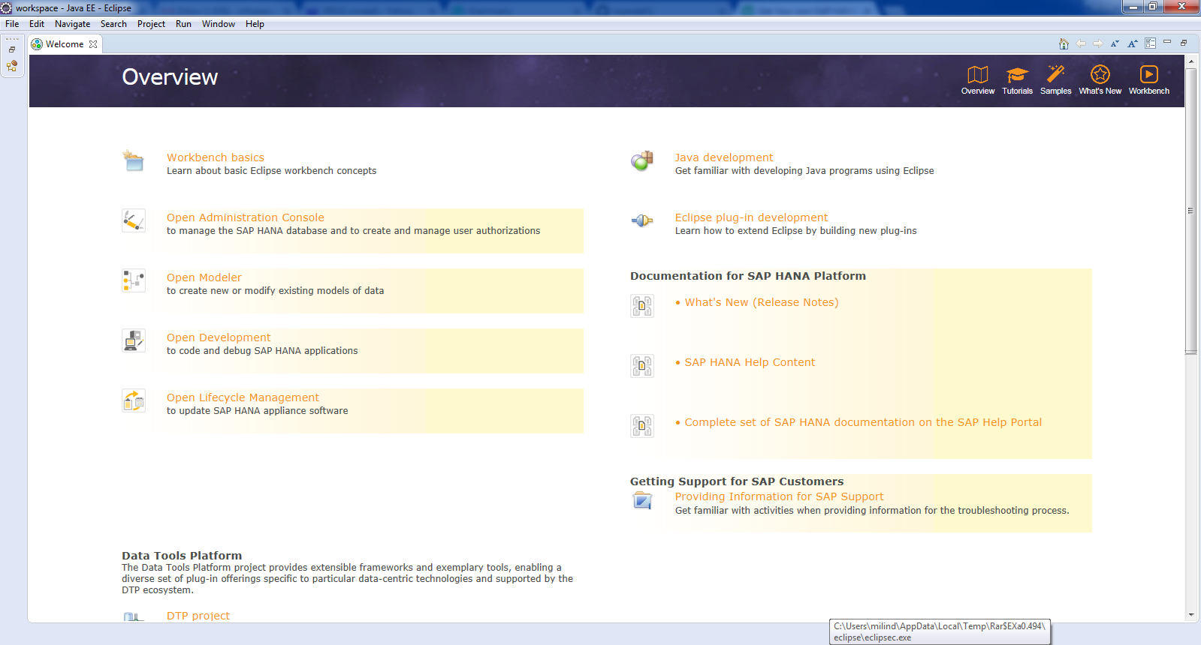
Eclipse restart with below screen.

Slide 20
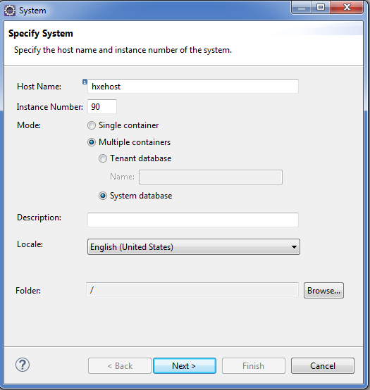
Cont.

Slide 21
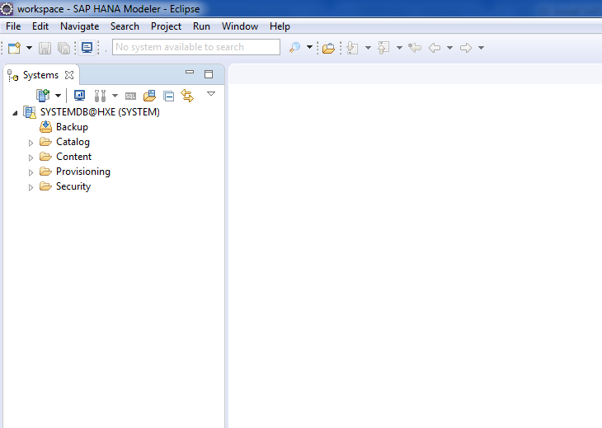
Cont.

Slide 22
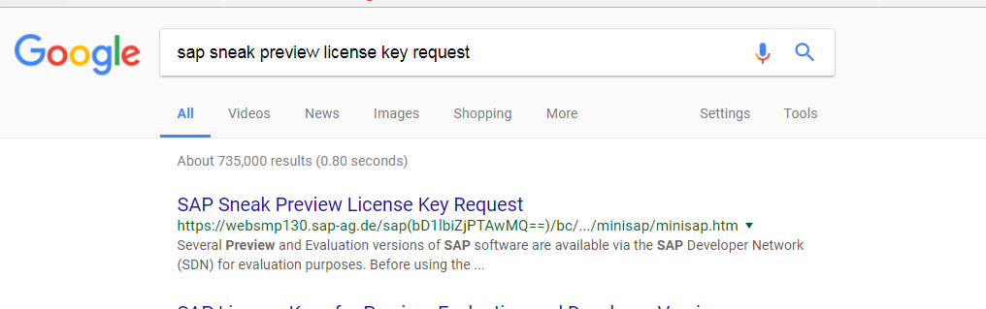
Go to SAP sneak preview.

Slide 23
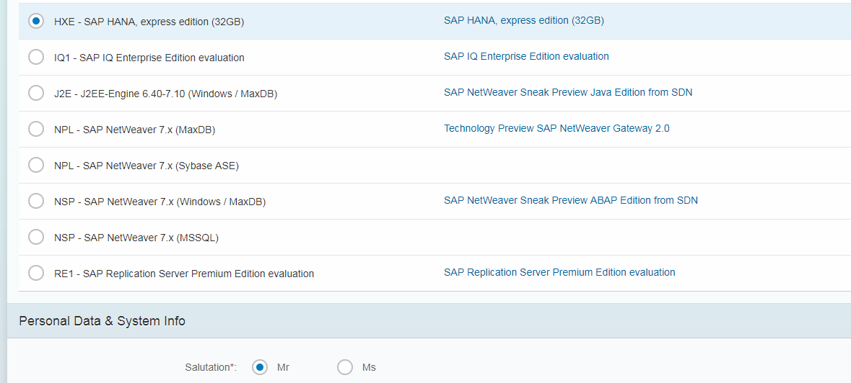
Generate License key.

Slide 24
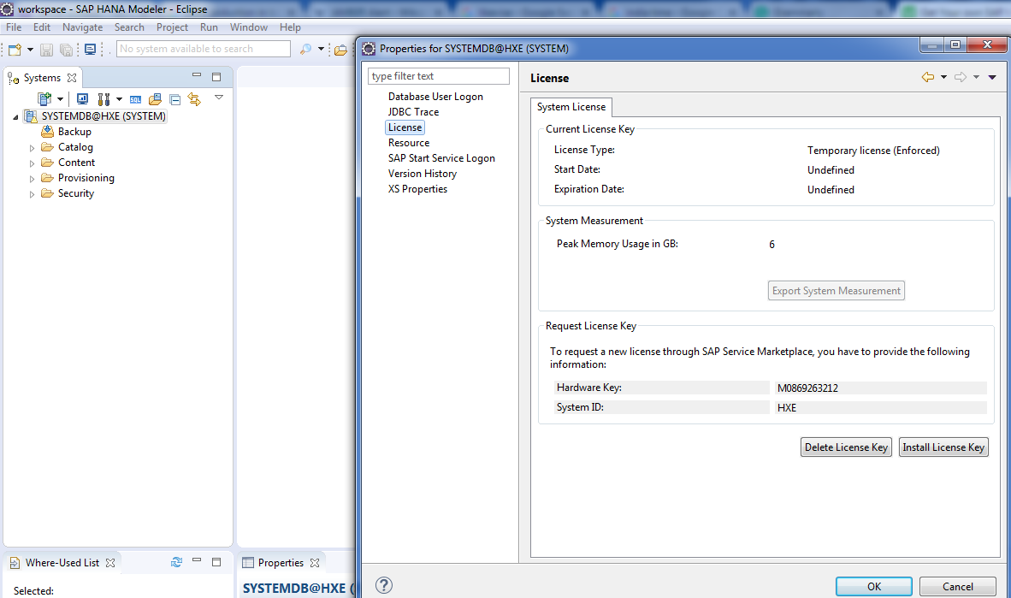
Right click→Properties→Licese. Copy Hardware Key.

Slide 25
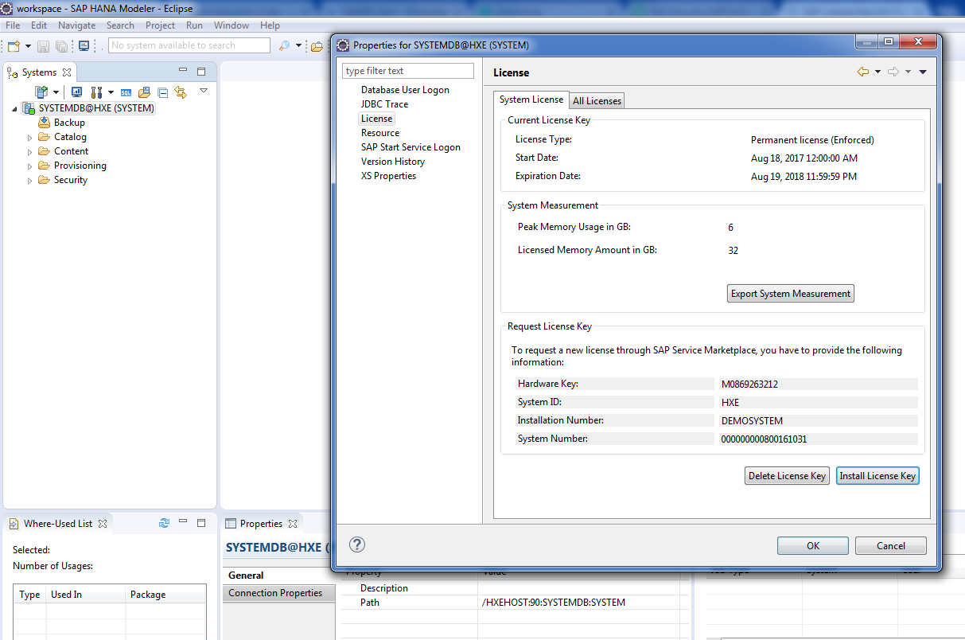
Install License key.

Slide 26
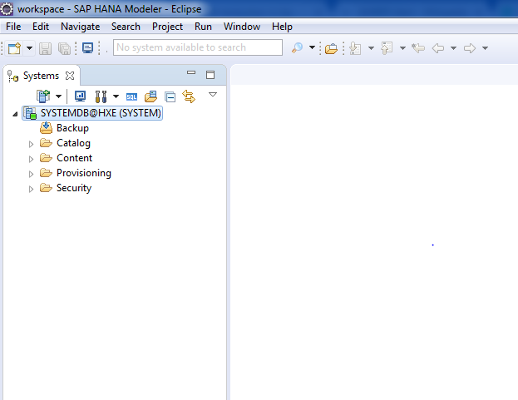
System icon would turn into Green!

